Slide 1
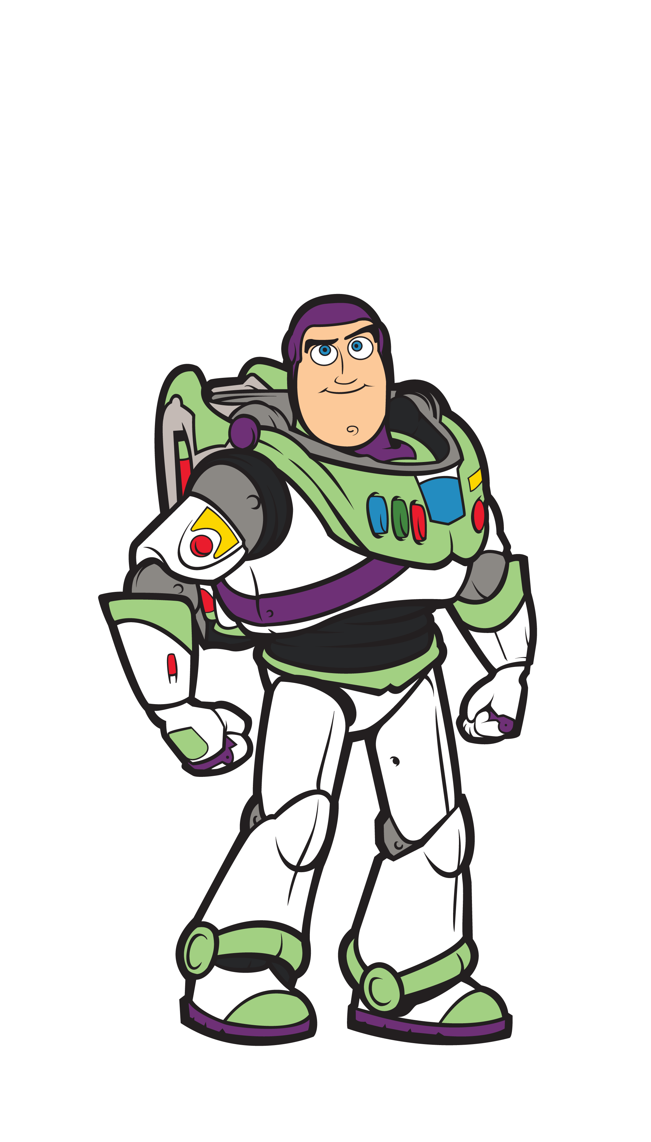
To Infinity and Beyond: Portfolios, Marketing Yourself, and More!

Slide 2
This is Just the Beginning…
Keep working on portfolio projects
Participate in a data contest
Stay in touch
Woz for Life

Slide 3
Portfolio Projects
You MUST have more than one project to be competitive
Get guidance from us
Best way to get a job in data science
Participate in data contests (ours or others like Kaggle)

Slide 4
Woz for Life
Remain in the slack channel
Access to all new workshops
New content updates by request
Career services for life (if you already have them)
Participate in contests, office hours, and any other extras

Slide 5
Marketing Yourself
Sell yourself
List out your strengths and weaknesses
Don’t be afraid to advocate for yourself
Battle imposter syndrome

Slide 6
Create an Elevator Speech
No more than a paragraph explaining:
Who you are
What you do
What your career goals are
Practice it
Use it in networking

Slide 7
Get Involved!
LinkedIn
Free conferences
Meet Ups
Stay connected to your fellow peers

Slide 8
Questions?

